Slide 1
Mini Project 3 Results
CS5567
Alexander Dowell

Slide 2
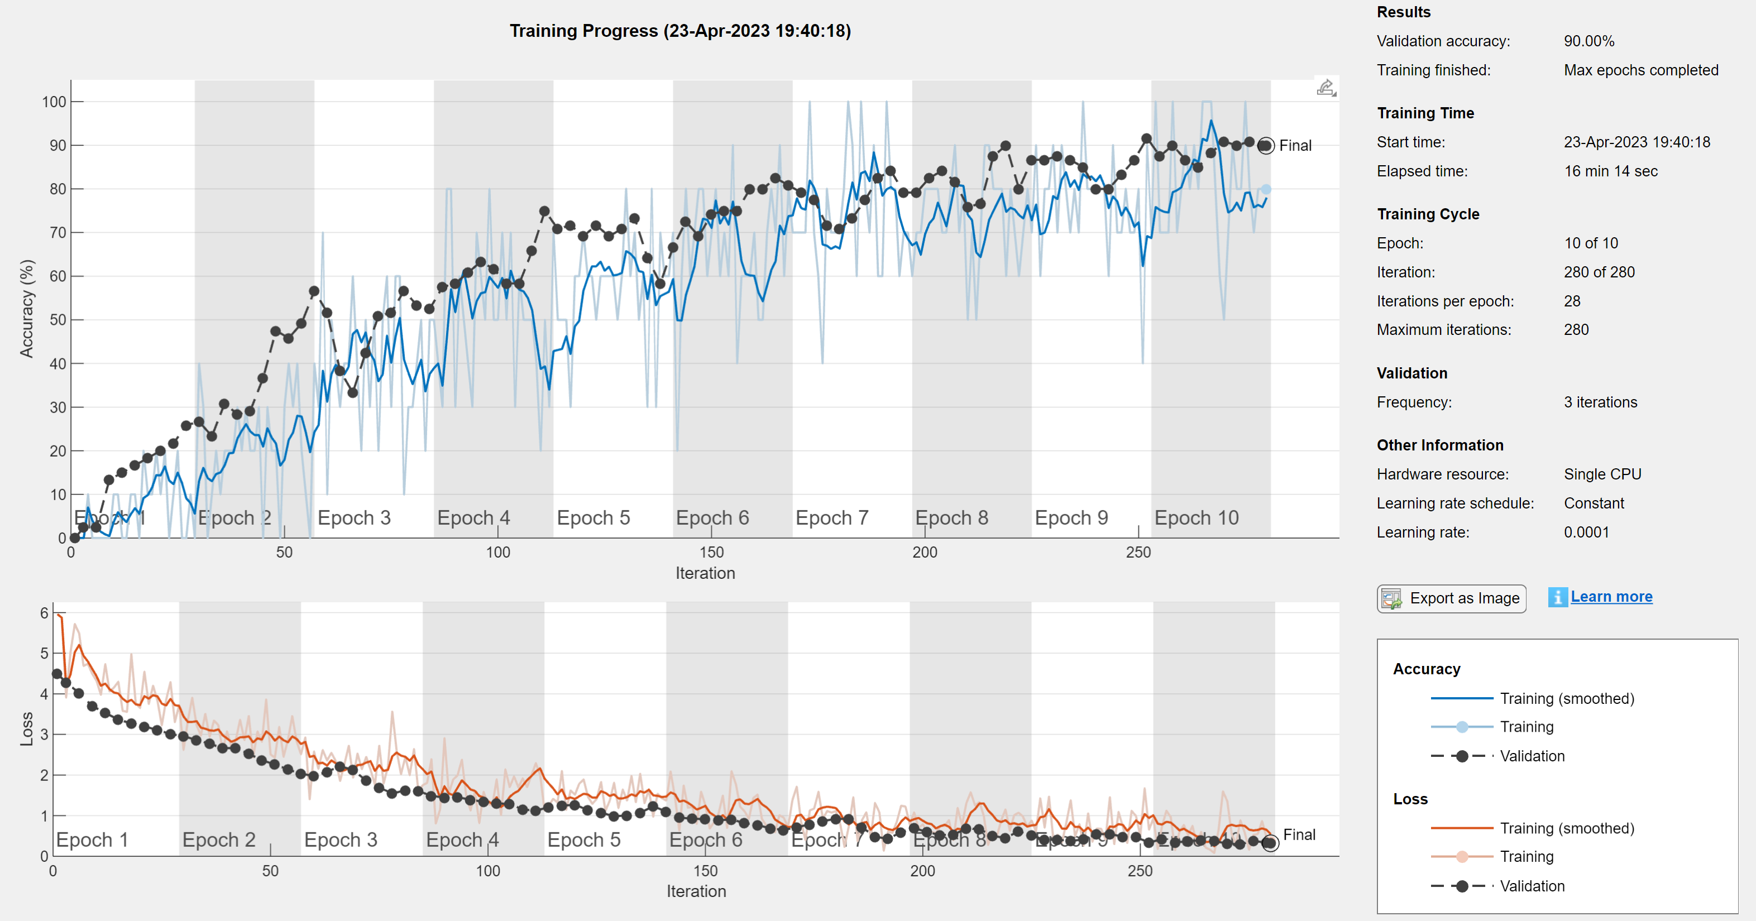
Results using Alexnet

Slide 3
Results using AlexNet continued
The modified network resulted validation accuracy is 90%, while the original MATLAB example achieved a 100% validation accuracy. The only parameter that was changed increased the maximum iterations from 6 epochs to 10. In some cases, a validation accuracy of 90% would be acceptable however retraining the modified network after changing some of the parameters like the learning rate, maximum epochs, training split, etc. would likely produce a higher validation accuracy.

Slide 4
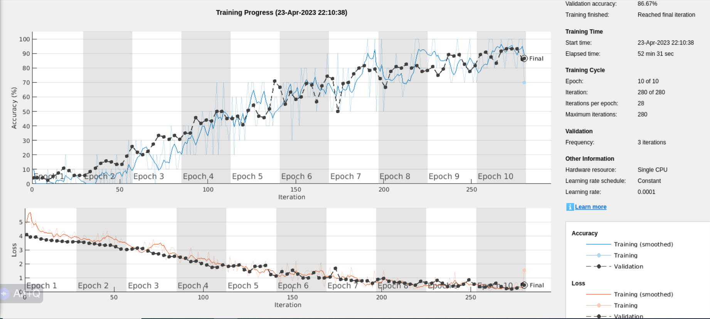
Results using VGG19

Slide 5
Results using VGG19 continued
The modified network using VGG19 resulted validation accuracy is 86.67%, while the original MATLAB example achieved a 100% validation accuracy. Just as the modified network using AlexNet the only parameter that was changed increased the maximum iterations from 6 epochs to 10. VGG19 is a much larger network than AlexNet so training takes much longer. Iteratively changing various parameters and retraining would likely increase the validation accuracy. Both networks produced similar results and even though VGG19 might perform slightly better if the validation accuracy requirement is or near 100%, Alexnet requires less memory and computation time so it is the preferred base network when building a transfer learning model.

